Slide 1
DASHBOARD PORTFOLIO

Slide 2
WORKING WITH MICROSOFT POWER BI

Slide 3
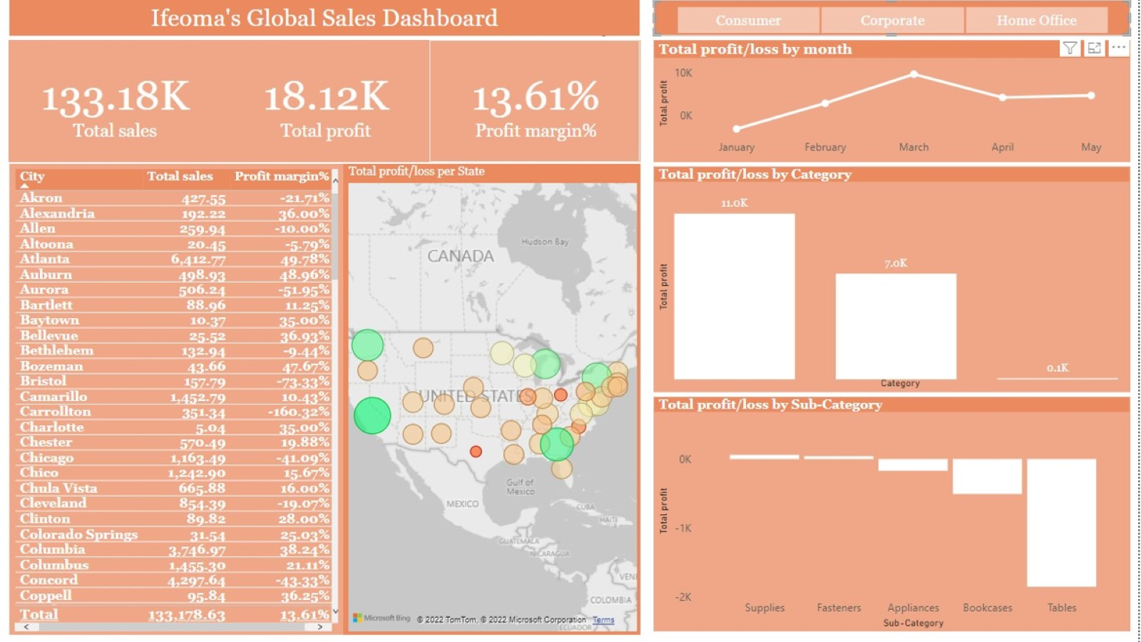

Slide 4
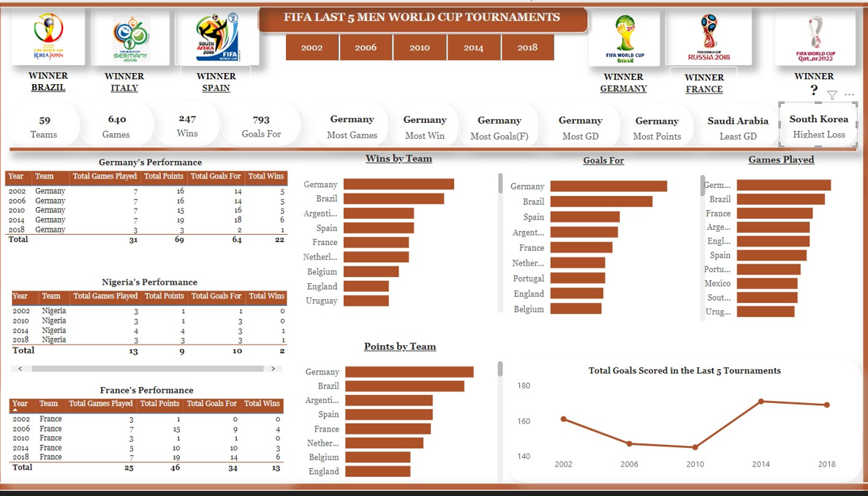

Slide 5
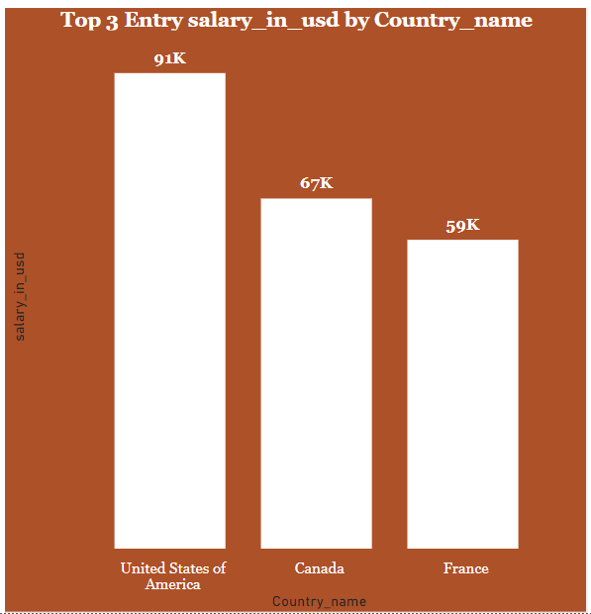
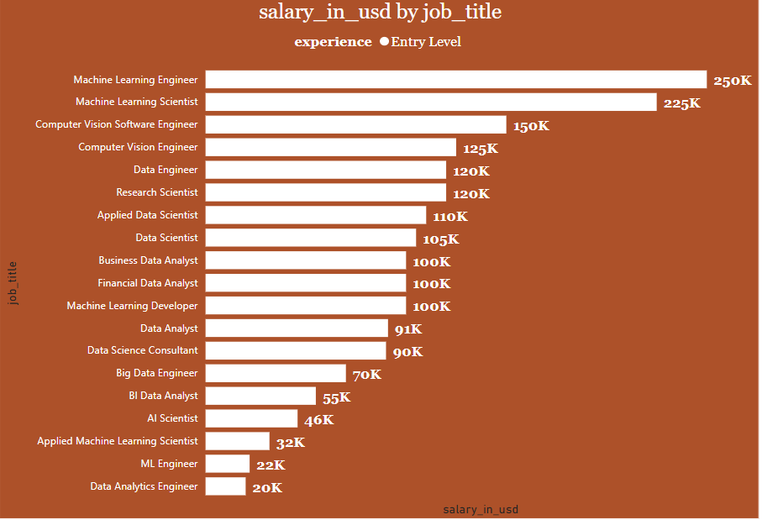
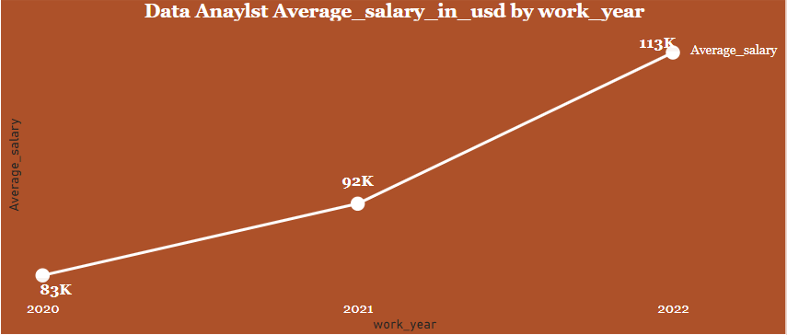
TREND OF DATA PROFESSIONALS ENTRY SALARY

Slide 6
WORKING WITH MICROSOFT EXCEL

Slide 7
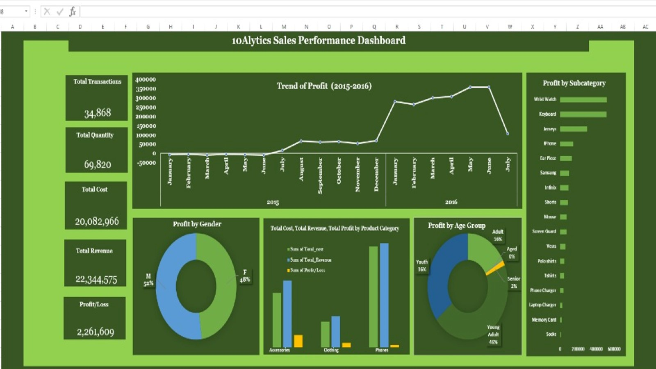

Slide 8
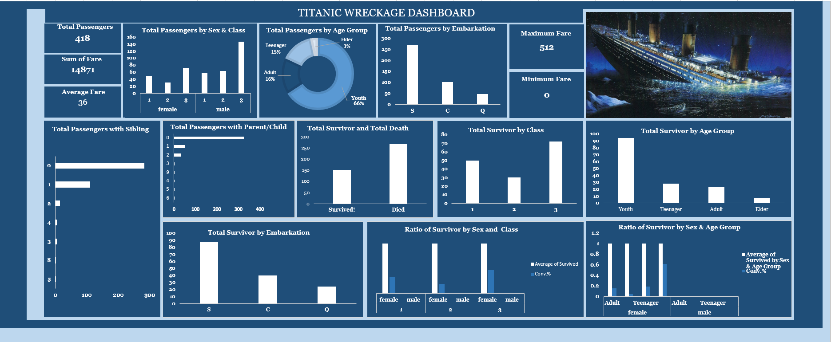

Slide 9
WORKING WITH PYTHON, SQL AND COGNOS ANALYTICS

Slide 10
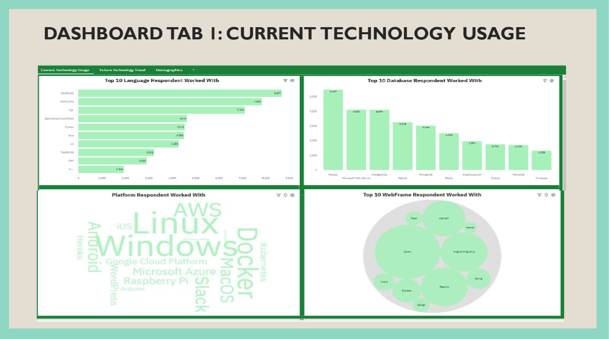

Slide 11
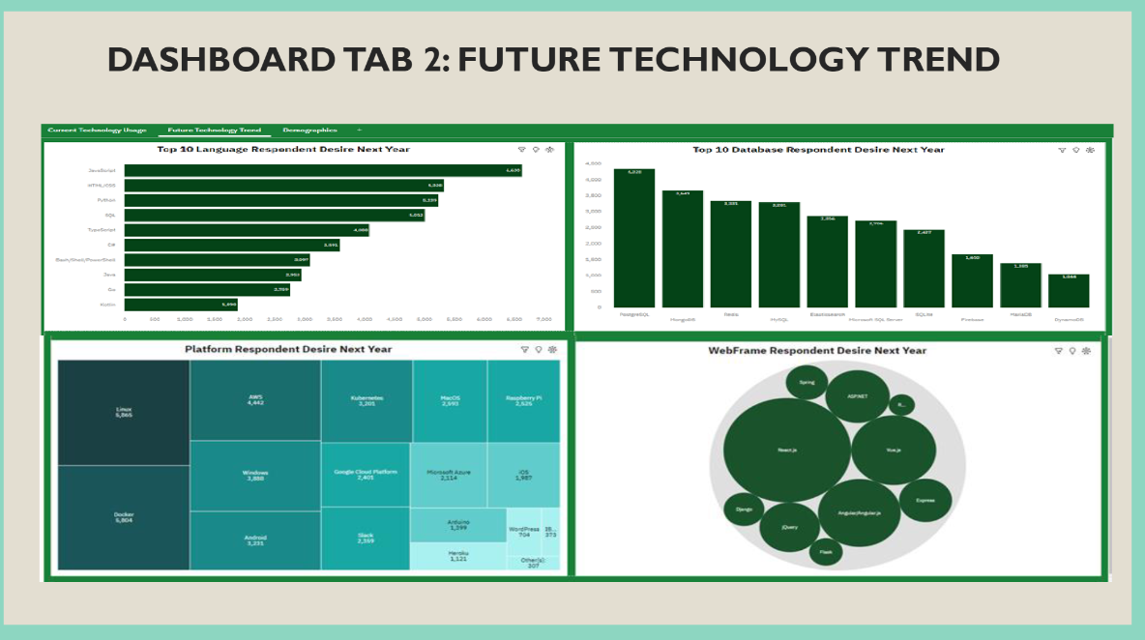

Slide 12
